Slide 1


THE
FACULTY OF
ENGINEERING
X THE PLACE OF USEFUL LEARNING
www.strath.ac.uk/engineering

Slide 2


Atomistic Simulations of Polymers for Sustainable Food Packaging Design
Nisha Middleton
MDAnalysis UGM
Sep 2023

Slide 3
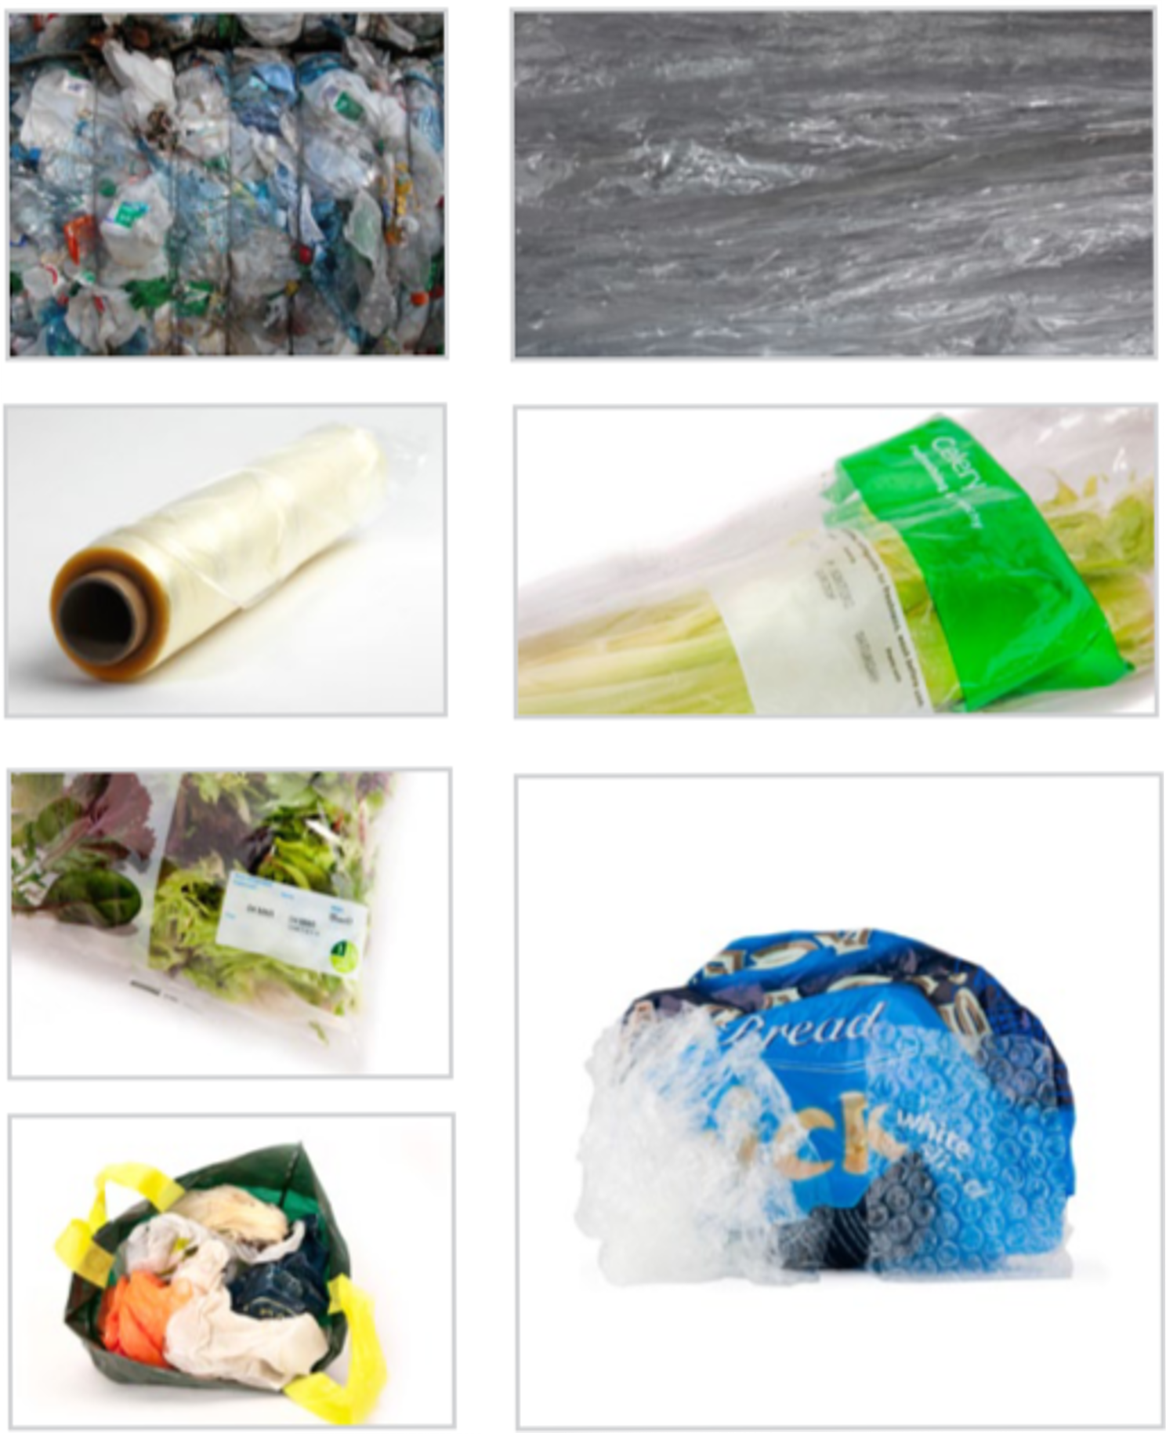
Plastic Film Packaging
Nearly 1/4 of UK consumer plastic¹
Increases shelf life of food
Only 7% currently recycled in UK¹
Lightweight, transparent, flexible
Increasing demand for sustainable alternatives
Multilayer components
1. The UK Plastics Pact Annual Report 2021-2022

Slide 4
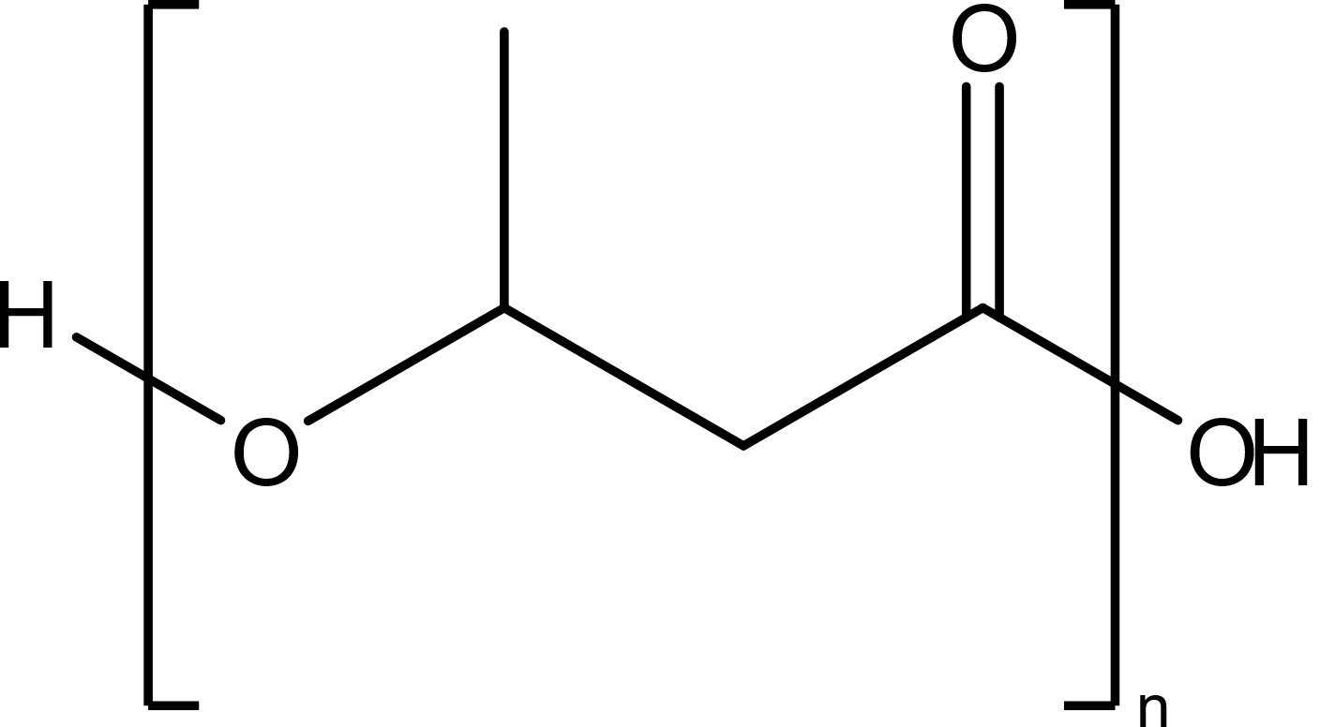
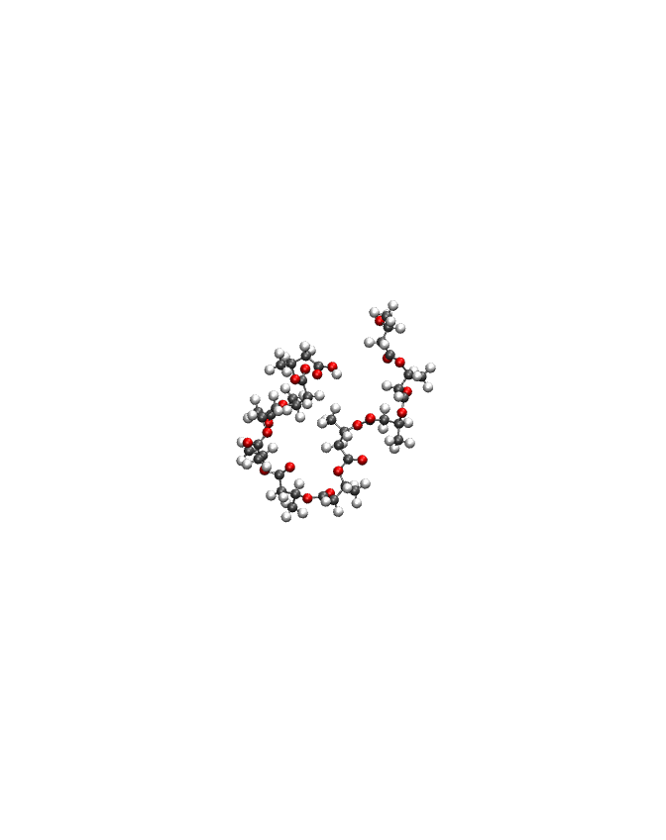
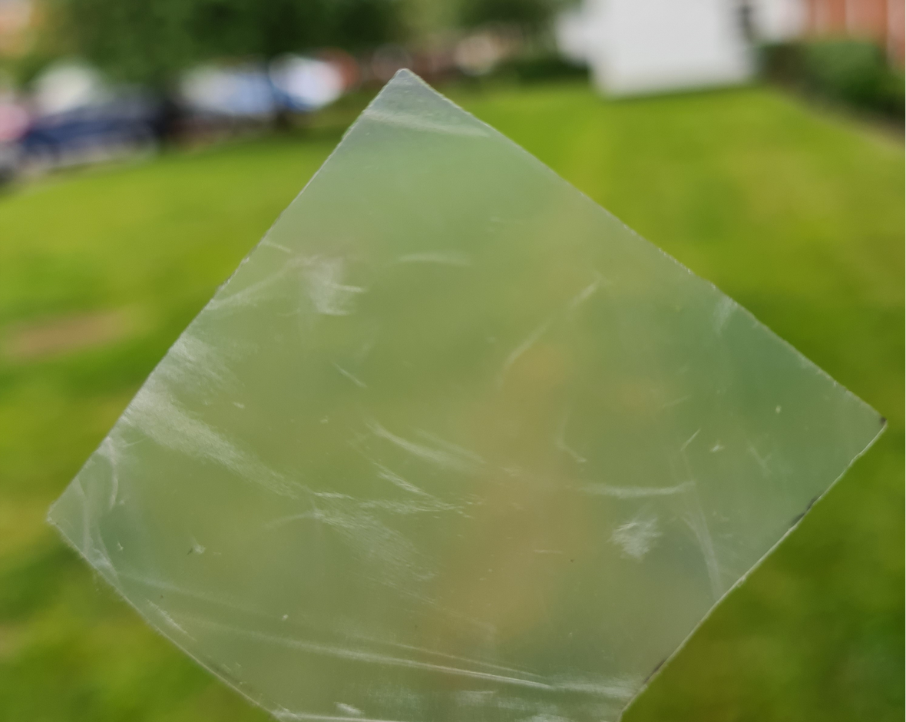
Polyhydroxybutyrate (PHB)
Bioderived and biodegradable
Semicrystalline polymer
Thermal and barrier properties comparable to conventional plastics
Pure PHB can be brittle due to high crystallinity
Can be tailored through copolymerisation and addition of fillers and plasticisers

Slide 5
Research Objective
Use molecular dynamics to investigate barrier properties by simulating diffusion of oxygen and water through the amorphous polymer matrix.

Slide 6
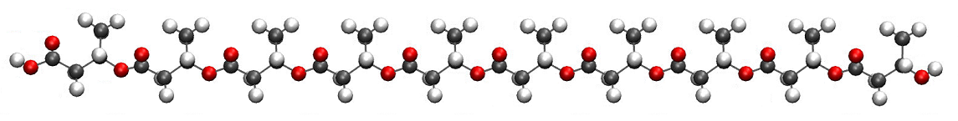

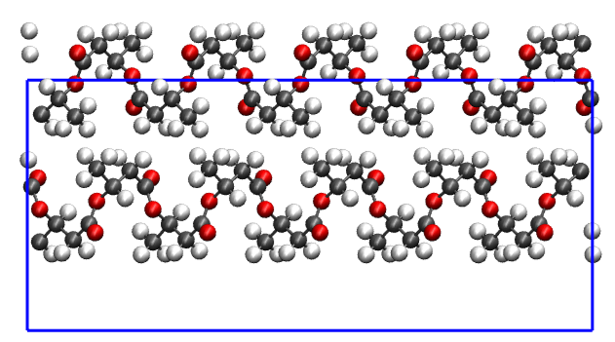
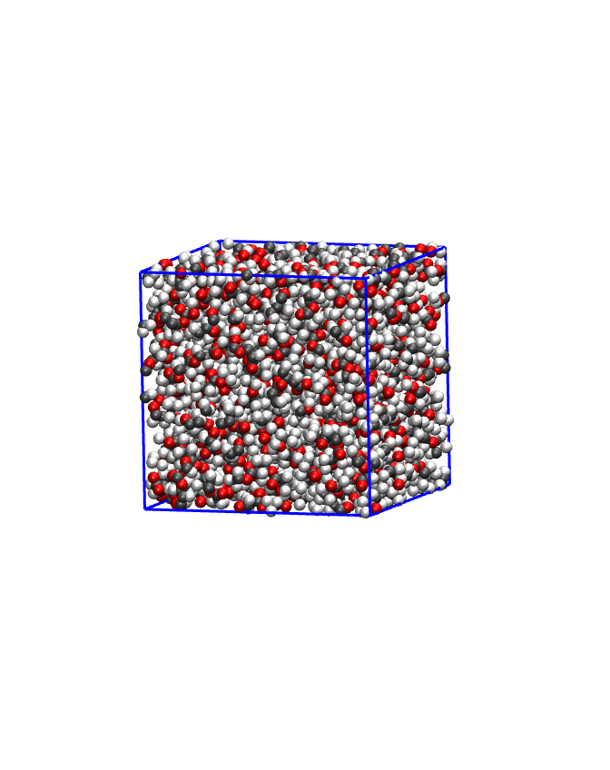
Simulation Method
General Amber Force Field¹ (modified)
amorphous polymer
PHB α-crystal
1. Wang, Junmei, et al. Journal of computational chemistry 25.9 (2004): 1157-1174.

Slide 7
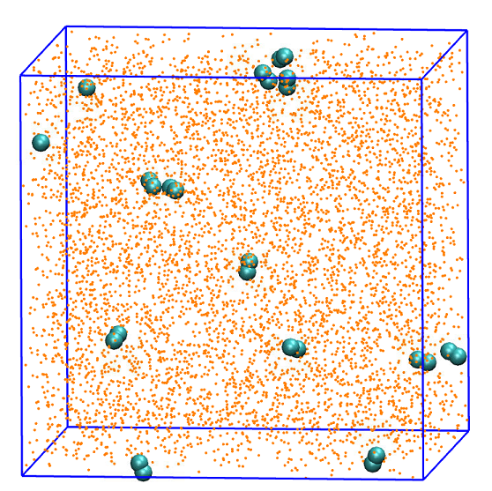
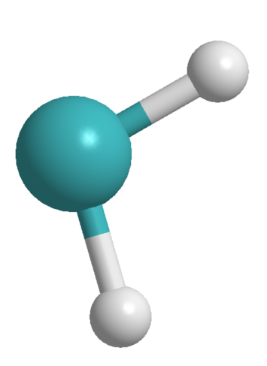
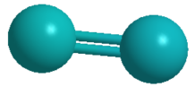
Simulation Method
H₂O
SPCE model¹
1ns NPT equilibration
200ns NVT production run
O₂
Monticelli model²
Berendsen, Herman JC, J. Raul Grigera, and Tjerk P. Straatsma. Journal of Physical Chemistry 91.24 (1987): 6269-6271
Javanainen, Matti, Ilpo Vattulainen, and Luca Monticelli. The Journal of Physical Chemistry B 121.3 (2017): 518-528.

Slide 8

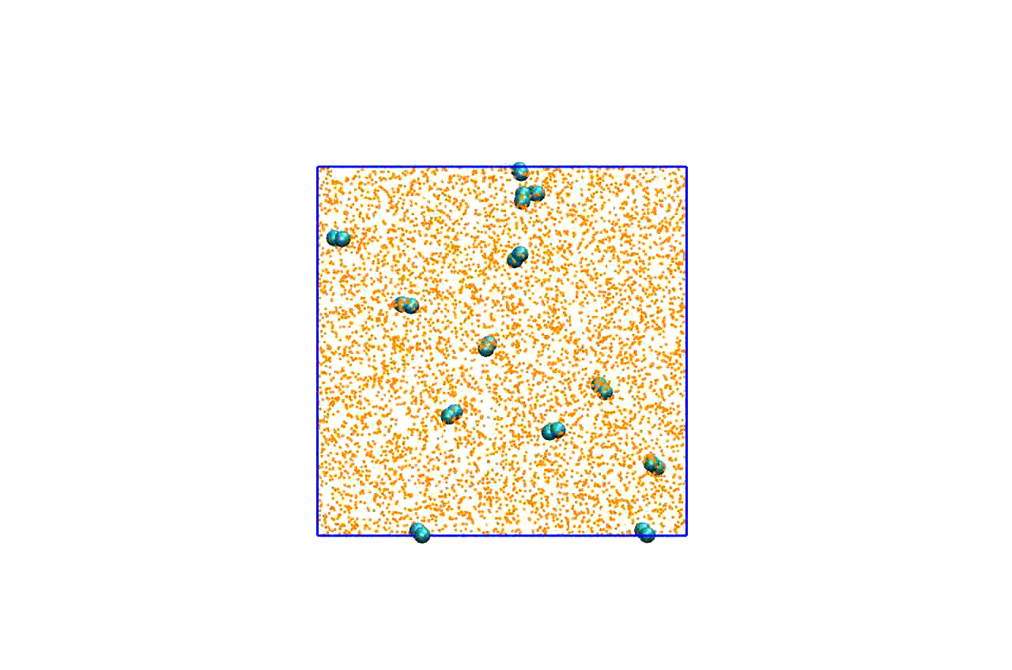
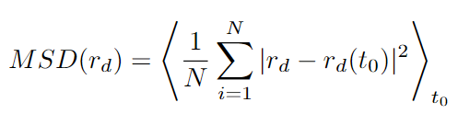
Post-Simulation Analysis
Mean squared displacement:
r = coordinates
d = dimensionality
N = number of atoms
⟨ ⟩_{t0} = average over time origins

Slide 9
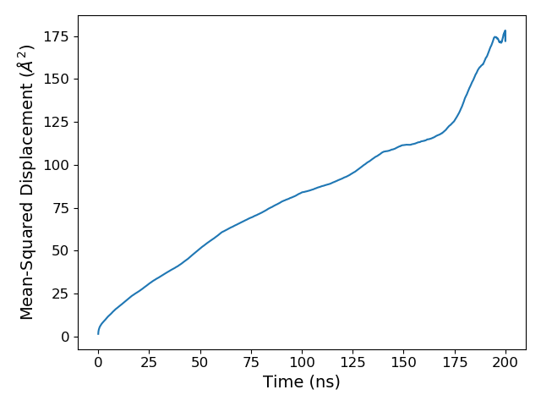
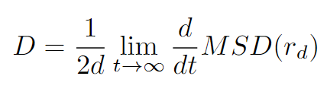
Post-Simulation Analysis
from scipy.stats import linregress
R² ≈ 1
Linear regression model used to calculate diffusion coefficient (D)
Einstein diffusion regime when R² and log-log slope ≈ 1

Slide 10
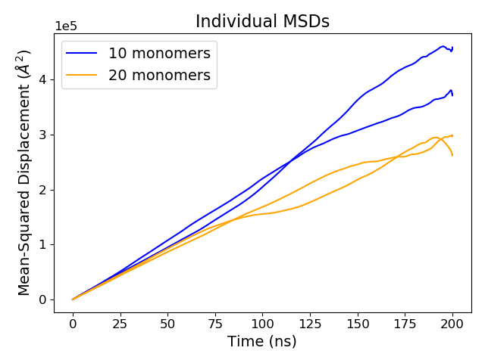
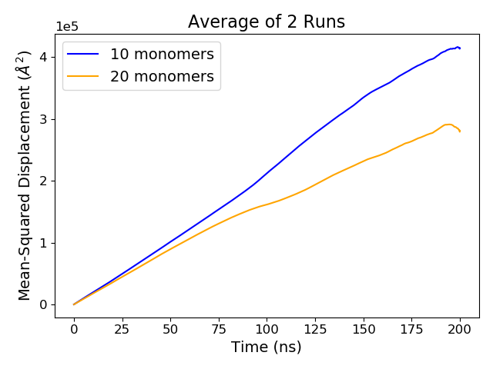
Oxygen Diffusion at 500K
Oxygen diffuses more in 10 monomer system due to chain relaxation timescales

Slide 11
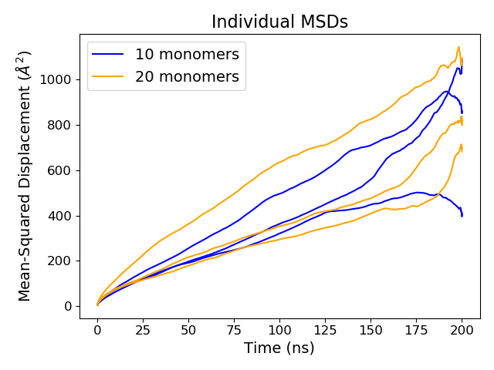
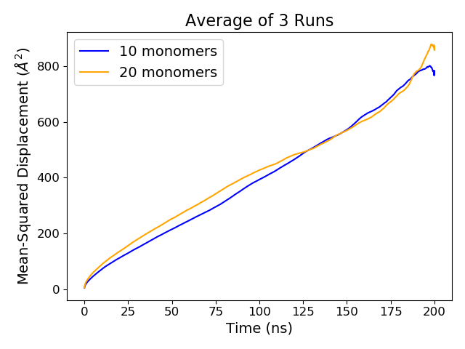
Oxygen Diffusion at 300K
At 300K diffusion is limited by polymer chain mobility

Slide 12
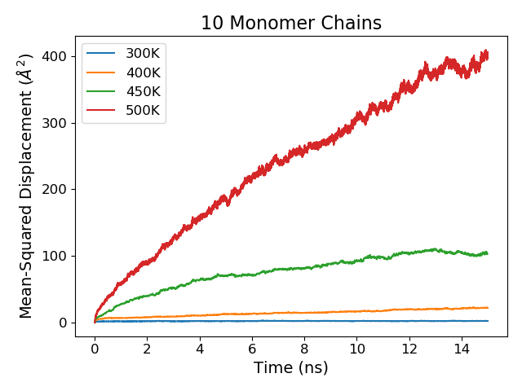
Polymer Chain Mobility
Polymer Displacement
Higher D values at higher temperatures due to increased polymer chain mobility
At 300K PHB model is below glass transition temperature

Slide 13
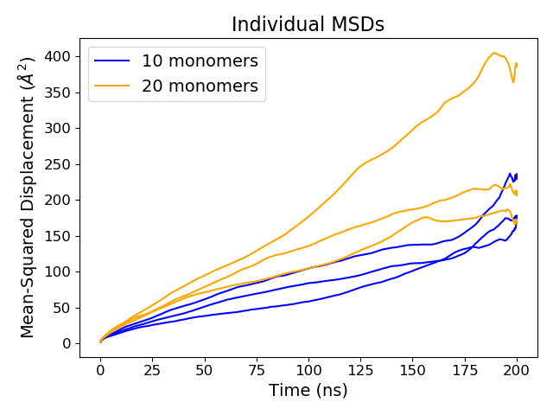
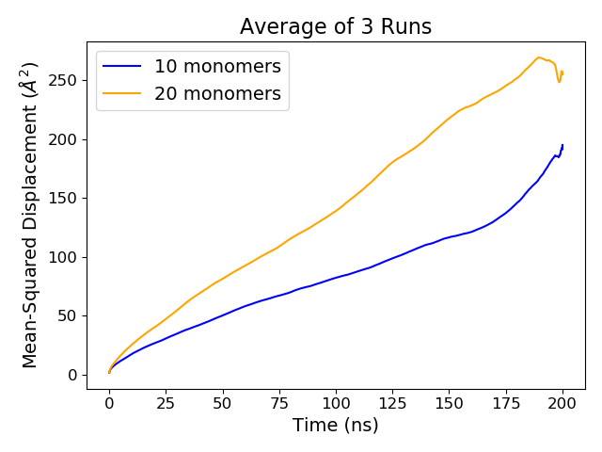
Water Diffusion at 300K
Water diffusion is slower in 10 monomer system

Slide 14
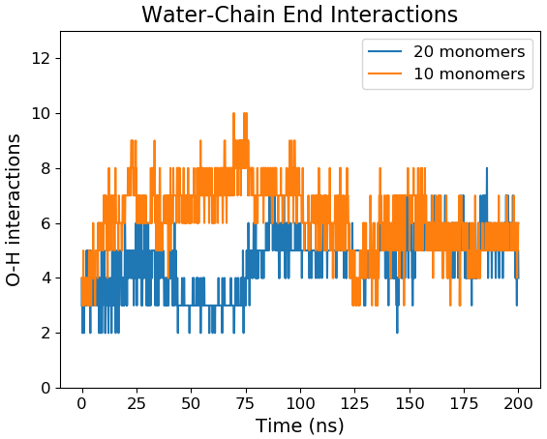
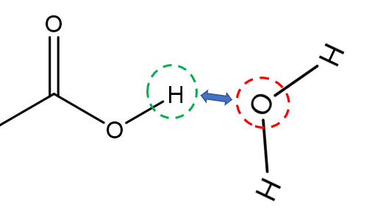
Effect of Chain Ends
D_{water} lower for 10 monomer chain due to interactions with polar chain ends
D_{oxygen} > D_{water} since oxygen is non-polar
3 Å

Slide 15
Diffusion Coefficient
D values in agreement with experiment
Permeant | System | Temp (K) | D (cm²/s)
Oxygen | 10 monomers | 500 | 3.76 x10⁻⁵
 | 20 monomers | 500 | 2.46 x10⁻⁵
 | 10 monomers | 300 | 6.05 x10⁻⁸
 | 20 monomers | 300 | 5.45 x10⁻⁸
 | Experimental¹ | 296 | 5.26 x10⁻⁸
Water | 10 monomers | 300 | 1.11 x10⁻⁸
 | 20 monomers | 300 | 2.23 x10⁻⁸
 | Experimental¹ | 298 | 2.17 x10⁻⁸
Higher D at 500K due to polymer chain mobility
D_{oxygen} > D_{water} ; PHB stronger barrier against water
accuracy ± 0.4%
1. Follain, Nadege, et al. The Journal of Physical Chemistry C 118.12 (2014): 6165-6177.

Slide 16
Comparison to Other Polymers
 | D_{water} (x10⁻⁸ cm²/s) | D_{oxygen} (x10⁻⁸ cm²/s)
PHB | 2.23 | 5.45
PLA^{1, 2} | 6.61 | 7.6
PET^{3, 4} | 0.85 | 1.16
PLA = bioderived & biodegradable
PET = petrochemically derived & non-biodegradable
1. Yoon, Jin‐San, et al. Journal of applied polymer science 77.8 (2000): 1716-1722.
2. Bao, Lihong, et al. Journal of membrane science 285.1-2 (2006): 166-172.
3. Sammon, C., J. Yarwood, and N. Everall. Polymer 41.7 (2000): 2521-2534
4. Lightfoot, Jasmine C., et al Macromolecules 55.2 (2021): 498-510

Slide 17
Conclusions
Permeant polarity and polymer chain mobility determine diffusion properties
Diffusion coefficients from simulations are in agreement with experimental values
PHB is a stronger barrier against water than oxygen
Barrier properties of PHB make it a promising candidate for food packaging applications

Slide 18
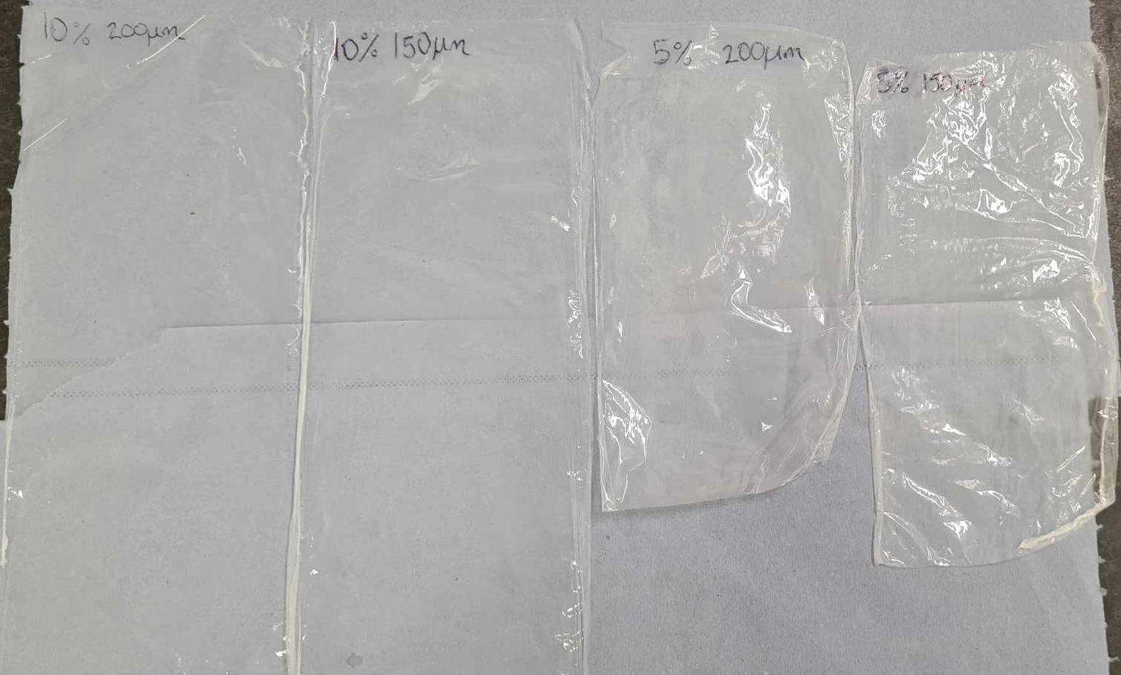
Future Work
Further analysis of H₂O and O₂ interaction with PHB
Investigate mechanical properties and crystallinity of PHB films
Measure barrier properties using a permeation cell with H₂O and O₂
Study effect of filler particles and plasticisers

Slide 19


To:
Acknowledgements
Supercomputer resources:
PhD funding:
Smart Sustainable Plastic Packaging (SSPP) research group:
Karen Johnston
Paul Mulheran
John Liggat
Vitor Magueijo
Katarzyna Majerczak
Dominic Wadkin-Snaith

Slide 20
X THE PLACE OF USEFUL LEARNING

